Slide 1
Business insights through data – individual assignment
Stefano Compagnone

Slide 2
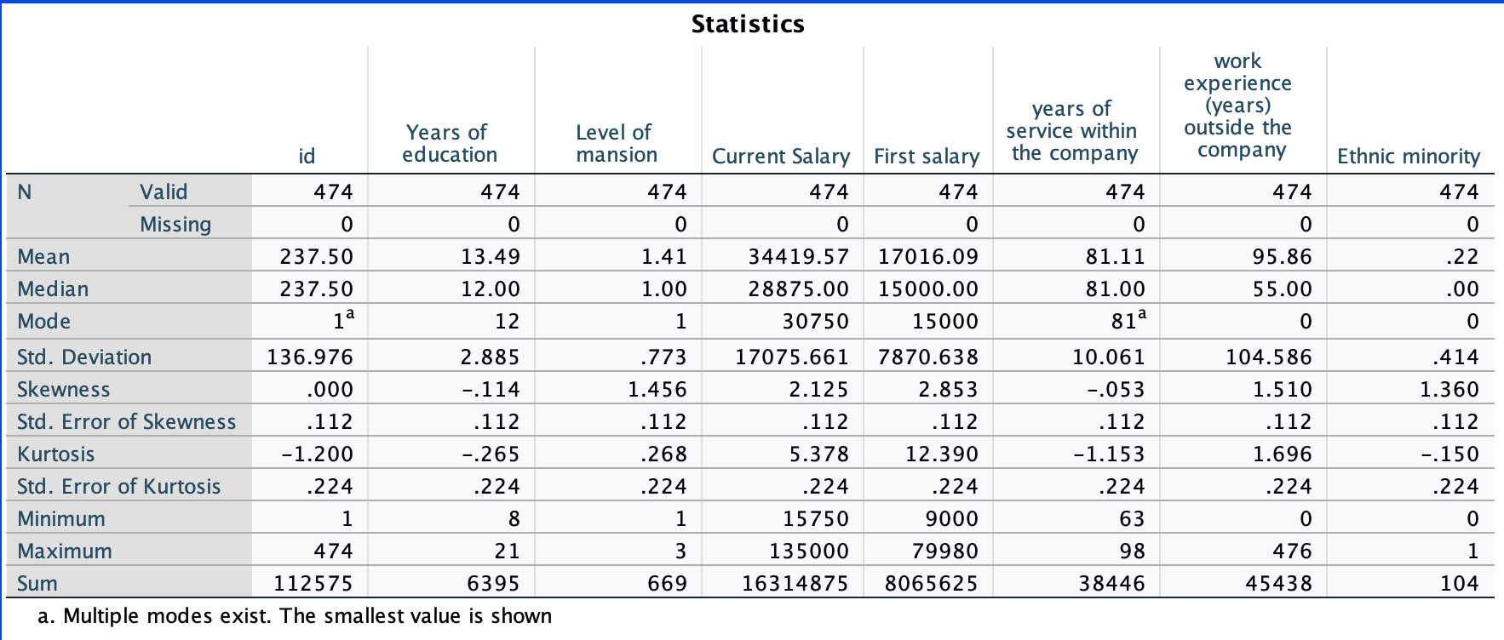

Slide 3
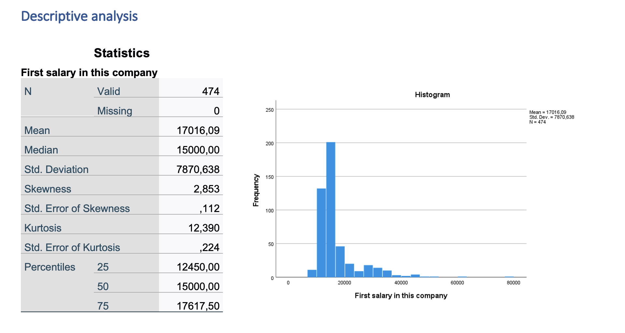
First salary in the company (beginning salary)

Slide 4
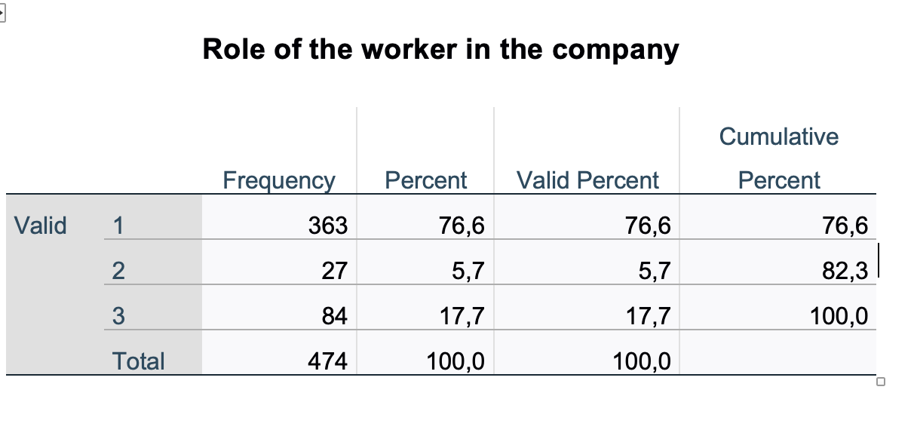
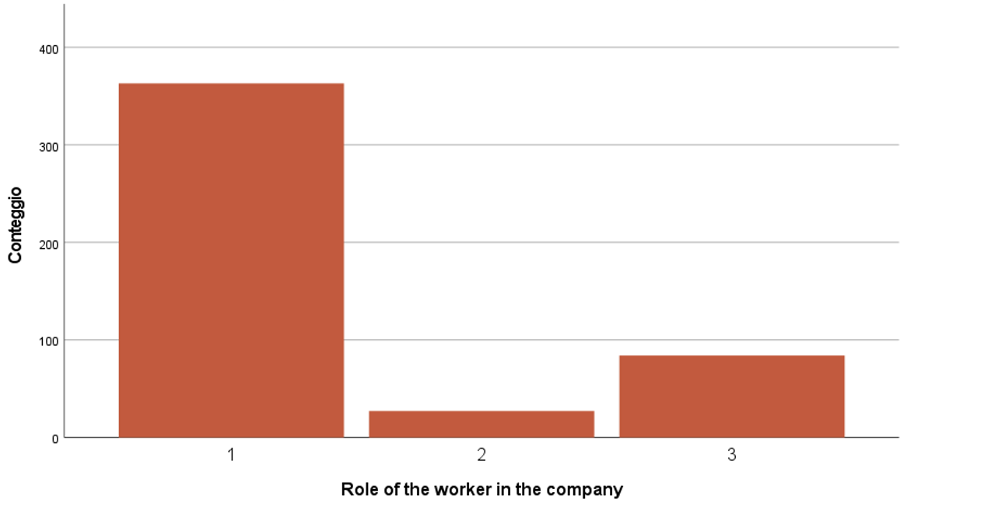
MANSION/ROLE OF WORKERS WITHIN THE COMPANY
According to the dataset, the majority of employees are in the first-level mansions/roles, while the highest status of employees is represented by a part of the population (17,7%) with respect to 5,7% of second-level employment.

Slide 5
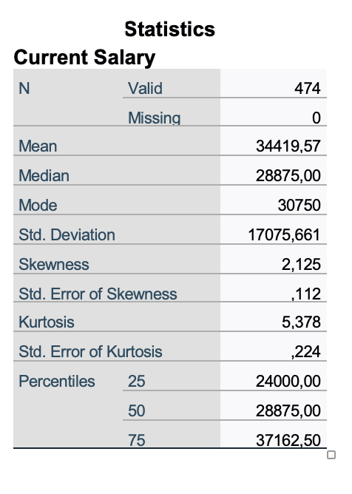
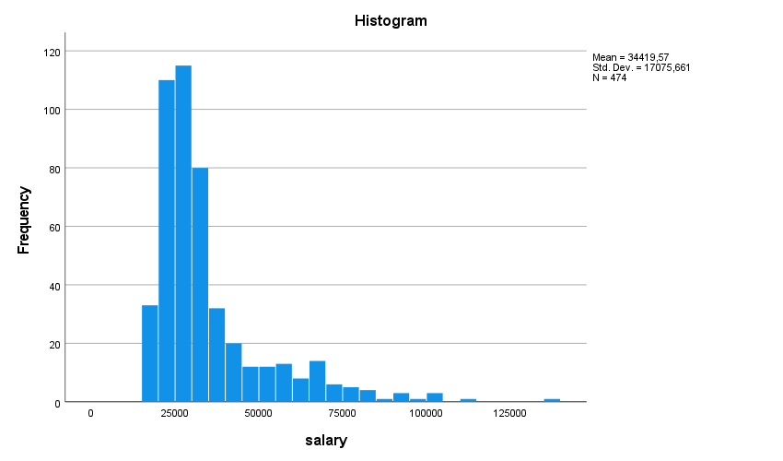
CURRENT SALARY

Slide 6
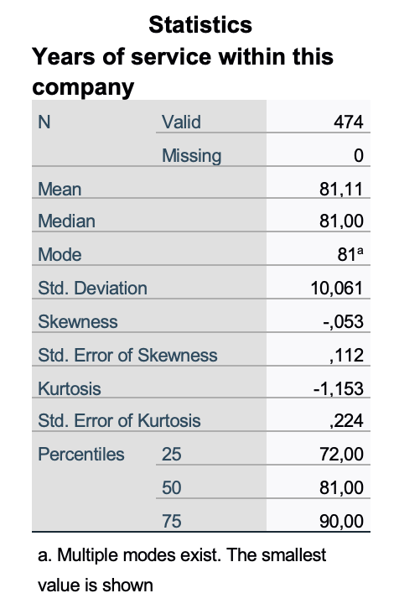
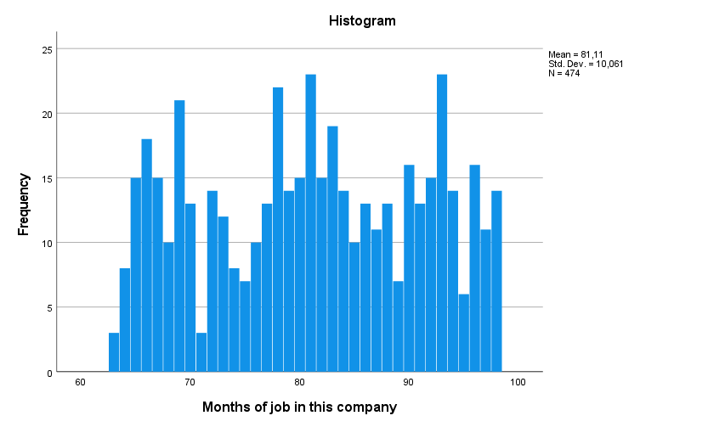
Years of service within this company
This data is homogeneous, with tails of the same height. In fact, the mean and the median have the same value. The skewness of the distribution is close to 0. From median to percentiles, we have only to subtract and add the same value (9, similar to standard deviation).

Slide 7
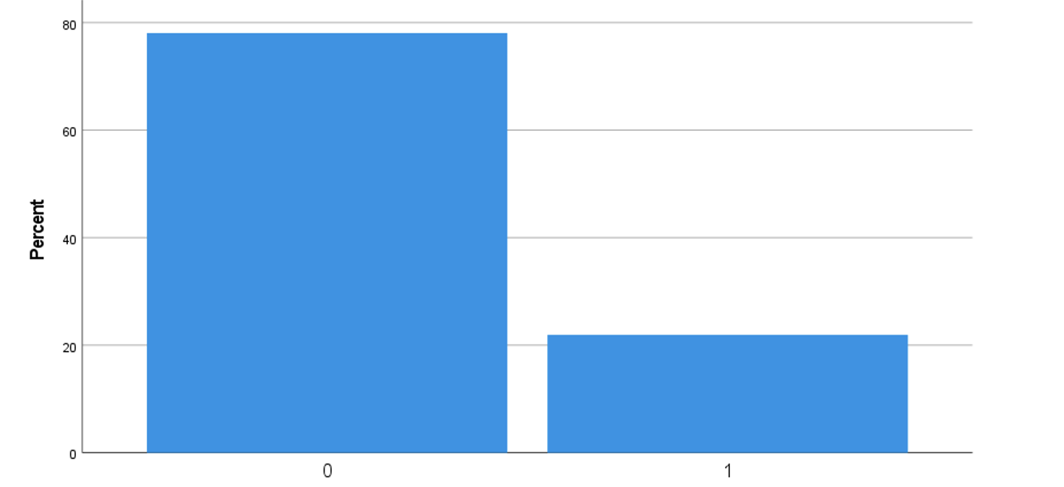
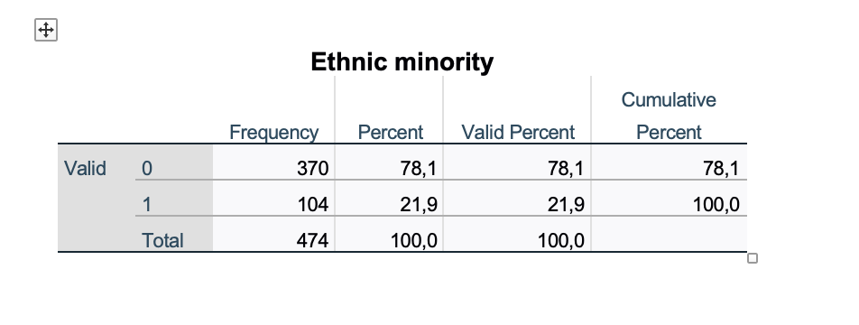
Ethnic minority
80% of the employees (370) aren’t a minority. Moreover, a small part of the sample (104 employees) belongs to a minority.

Slide 8
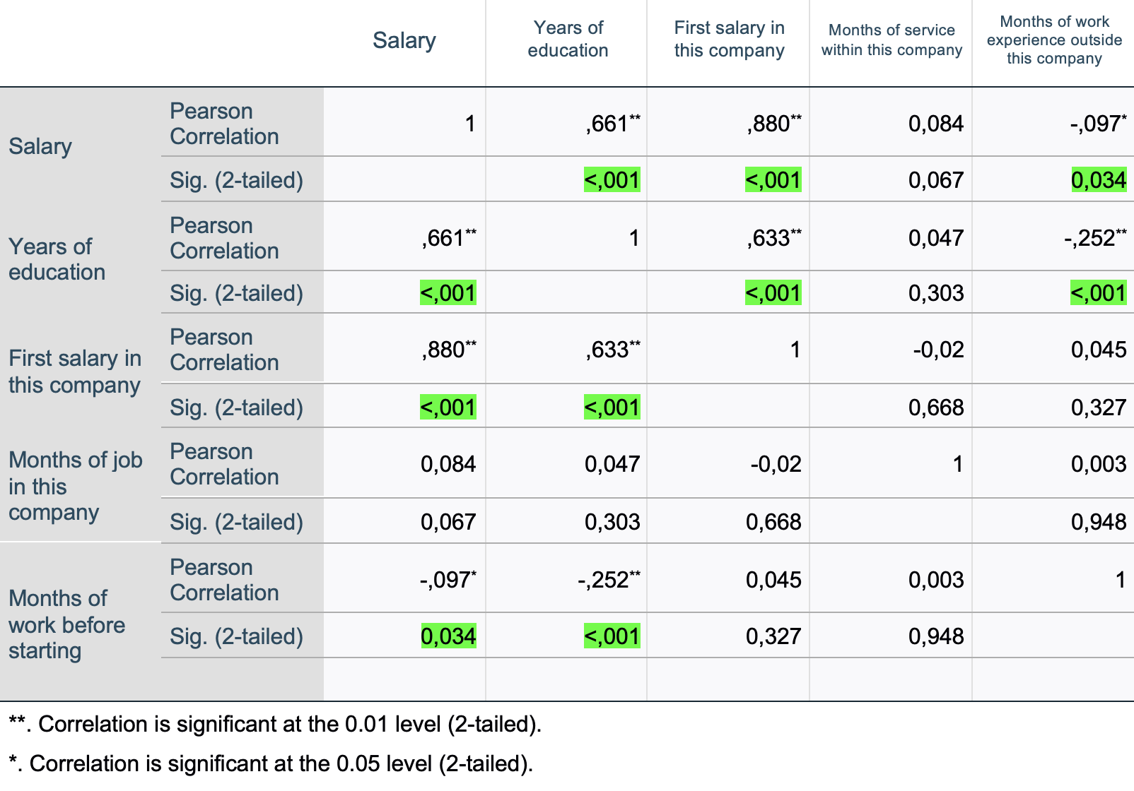
Pearson correlation
The Pearson analysis show a clear positive and strong correlation between current Salary and first Salary
within the company [0.88].
Another strong positive correlation is present in the relationship between years of education and Salary [0.66].
In addition, a significant negative correlation exist between current salary and months of work experience outside the company.

Slide 9
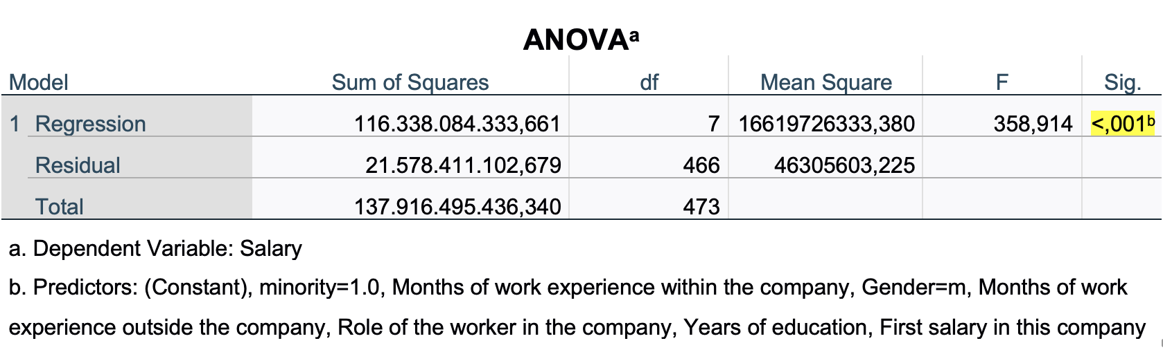
LINEAR REGRESSION
The ANOVA test turns out to be statistically significant (p-value < 0.001), we can therefore reject the null hypothesis, according to which the estimated coefficients β of the regression are all equal to 0.
As a consequence of the negative result of the Anova test, I arranged the coefficient testing subsequently shown.

Slide 10
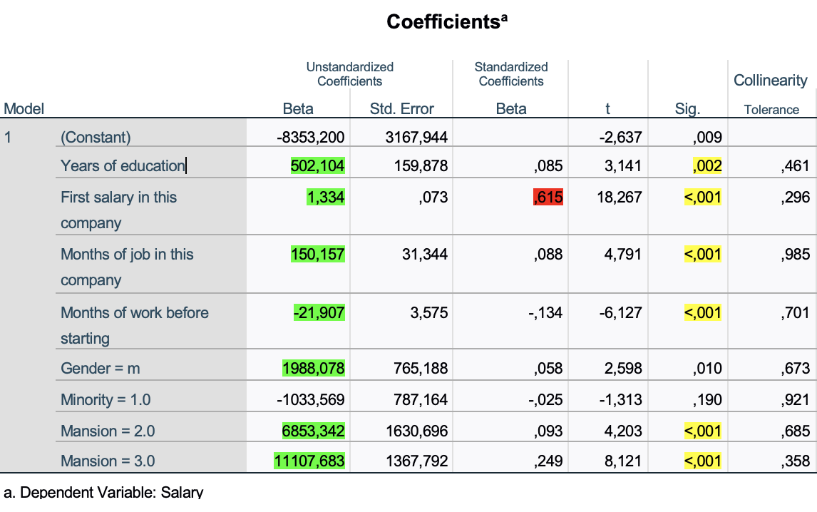
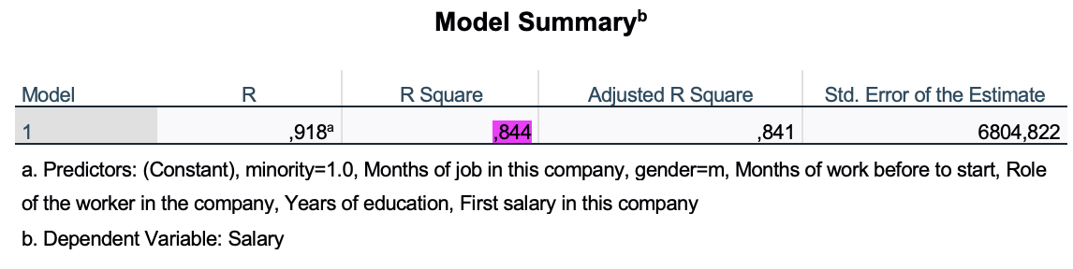

Coefficients
Comments on findings (all statistically significant variables (P<0.05))
The variation of only one year of education implies a salary higher than 502$.
Each dollar ($) earned from the first salary corresponds to an increase of 1,33$ on the current salary.
Each month of work within the company corresponds to an average gain of 150$ on every month.
Employees with second-level employment status within the company earn on average 6.853$ more than those with first-level employment status.
Employees with third-level employment status within the company earn on average 11.107$ more than those with first-level employment status.
In this company, women earn on average 1.988$ less than men.
According to the Beta coefficient, the variable with absolute value has the greatest influence on the dependent variable. In this case, it turns out to be space adequacy (Beta=0,615).
The $R^{2}$ index turns out to be equal to 0.844, therefore the model can explain 84,4% of the overall variance of the dependent variable.

